Slide 1
Weapon Detection System
Group Members
Eisha Arif 296109
Aliza Qamer 296033
M. Abdullah Bilal 287185
M. Umer Zia 283740

Slide 2
Introduction
Importance of Weapon Detection Systems
These are used in security applications in recognition of criminal data with the help of threats detected from surveillance systems.

Slide 3
Problem at Hand
Using Yolov5 Object Detection Model
In traditional video surveillance, security agents have to visually detect the presence of weapons in monitored scenes by watching security footage and quickly making decisions based on it.
We aimed to solve this issue by using latest state-of-the-art model on real time data via fine tuning.

Slide 4
DataSet Formation
We combined 3 datasets from Kaggle.com
Guns Dataset
This included pistols, shotguns and rifle.
Knife Dataset
Grenades Dataset
Roboflow is website that helps custom dataset formation and training.

Slide 5
Algorithm Used
YOLOv5
YOLO an acronym for 'You only look once', is an object detection algorithm that divides images into a grid system. Each cell in the grid is responsible for detecting objects within itself.
YOLOv5 is one of the most famous object detection algorithms due to its speed and accuracy.

Slide 6
Pre-processing
Roboflow was used to pre-process our customized dataset.
Images were annotated manually with the Roboflow annotation tool.

Slide 7
Following split was performed:
Training Data: 70%
Validation Data: 20%
Testing Data: 10%
Auto orient: Applied
Resize: Stretch to 416x416
Augmentation applied were 90 ̊ rotation and -15 ̊ to +15 ̊ tilt.

Slide 8
Training
4 models were fine-tuned on pre-defined Yolov5 model.
Hyperparameters tuned:
epochs
batch size
Dataset size incremented
Augmentation modification
Number of Classes

Slide 9
Epochs
Model 1 | Model 2 | Model 3 | Model 4
60 | 100 | 200 | 200
Batch Size
Model 1 | Model 2 | Model 3 | Model 4
10 | 16 | 12 | 10
Dataset Size (# of images)
Model 1 | Model 2 | Model 3 | Model 4
33 | 352 | 395 (530) | 448 (689)
Number of Classes
Model 1 | Model 2 | Model 3 | Model 4
1 | 5 | 5 | 5

Slide 10
Final Model
Dataset Modifications
Dataset Size | 509 images
Augmented Dataset Size | 1196 images
Training Set | 1000 images
Validation Set | 94 images
Testing Set | 71 images
Augmentation | Outputs per training example: 3 90° Rotate: Upside Down Rotation: Between -45° and +45° Bounding Box: Rotation: Between -15° and +15°
Number of Classes (Name(s)) | 5 (pistols, rifle, shotgun, knife, grenade)
Modified Model Parameters
Number of Epochs | 100
Number of iterations | 4
Weights in Iterations | No weights, “./runs/train/yolov5s_results9/weights/best.pt”
Batch size | 10

Slide 11
Analysis
The precision (P) metric was used in the evaluation of the weapon images in the dataset.
Expected P | Actual P
97.5% | 74.7%

Slide 12
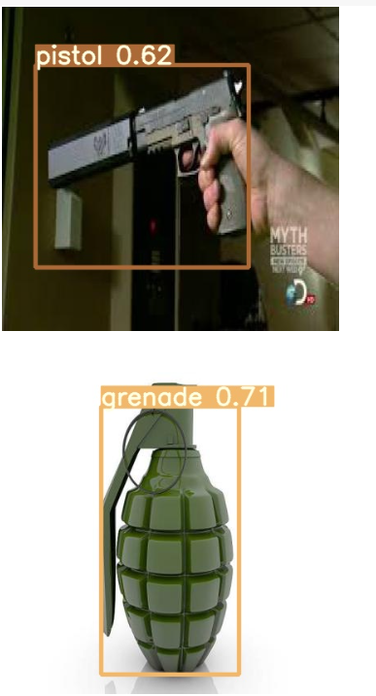
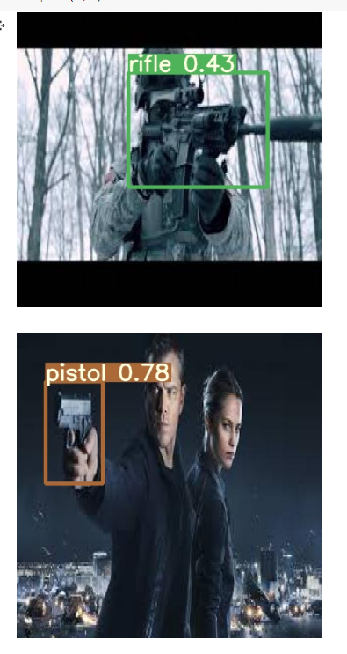
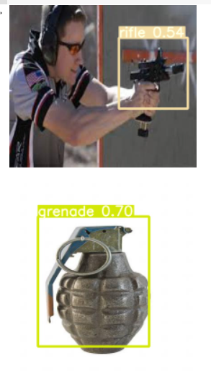
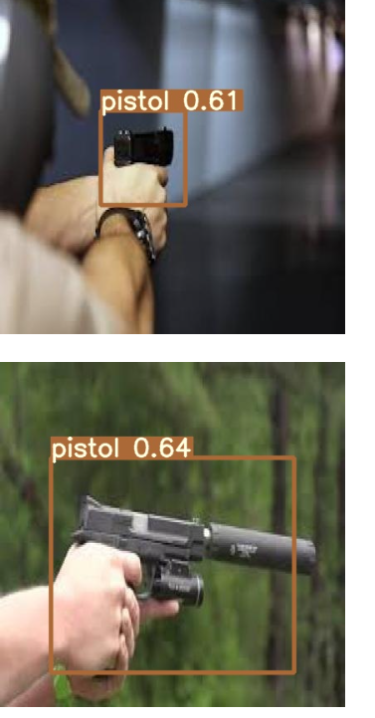
Some detected results

Slide 13
Comparison
Related work on weapon detection has about 82% accuracy.
Most work is done using Yolov3 model.
Our Dataset, even though given the possibility of ambiguous annotations, augmentation and smaller dataset size, has given good results overall.

Slide 14
Conclusion
In this study, a new dataset consisting of five different weapon types was constructed.
The newly fine-tuned model showed very good performance by successfully detecting weapon images with different backgrounds.
The state-of-the-art pretrained YOLOv5 model has blazing fast performance indeed!

Slide 15
Thanks!
Any questions?

